Slide 1

Code Coverage & Continuous Integration
Jared O’Neal
Mathematics and Computer Science Division
Argonne National Laboratory
Better Scientific Software Tutorial SC19, Denver, Colorado
See slide 2 for license details
Notes:
Designed to be 15 Minute Talk + 20 minutes for the live Travis CI demo

Slide 2
License, Citation and Acknowledgements
License and Citation
This work is licensed under a Creative Commons Attribution 4.0 International License (CC BY 4.0).
The requested citation for the overall tutorial is: David E. Bernholdt, Anshu Dubey, Michael A. Heroux, and Jared O’Neal, Better Scientific Software tutorial, in SC ‘19: International Conference for High Performance Computing, Networking, Storage and Analysis, Denver, Colorado, 2019. DOI: 10.6084/m9.figshare.10114880
Individual modules may be cited as Module Authors, Module Title, in Better Scientific Software Tutorial…
Acknowledgements
Alicia Klinvex
This work was supported by the U.S. Department of Energy Office of Science, Office of Advanced Scientific Computing Research (ASCR), and by the Exascale Computing Project (17-SC-20-SC), a collaborative effort of the U.S. Department of Energy Office of Science and the National Nuclear Security Administration.
This work was performed in part at the Argonne National Laboratory, which is managed managed by UChicago Argonne, LLC for the U.S. Department of Energy under Contract No. DE-AC02-06CH11357.

Slide 3
Code Coverage

Slide 4
How do we determine what other tests are needed?
Code coverage tools
Expose parts of the code that aren’t being tested
gcov
standard utility with the GNU compiler collection suite
Compile/link with –coverage & turn off optimization
counts the number of times each statement is executed
lcov
a graphical front-end for gcov
available at http://ltp.sourceforge.net/coverage/lcov.php
Hosted servers (e.g. coveralls, codecov)
graphical visualization of results
push results to server through continuous integration server
Notes:
Gcov page suggests turning off optimization as we want to know if each line in the listing is called and if so how many times. With optimization, we cannot map those counts to the lines in the listing.
I also find information in the gcov about compiling with the two flags -fprofile-arcs -ftest-coverage to generate the gcov output files. --coverage is apparently a shortcut for both of these.

Slide 5
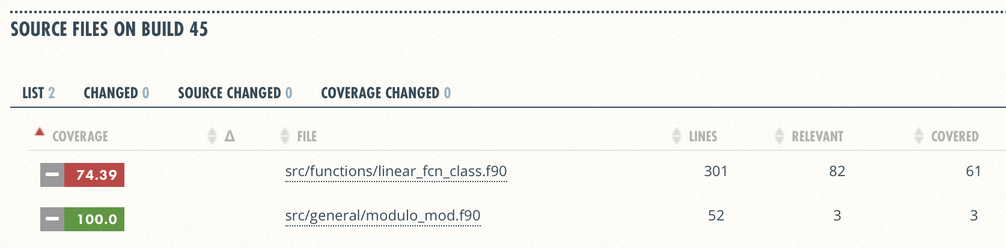
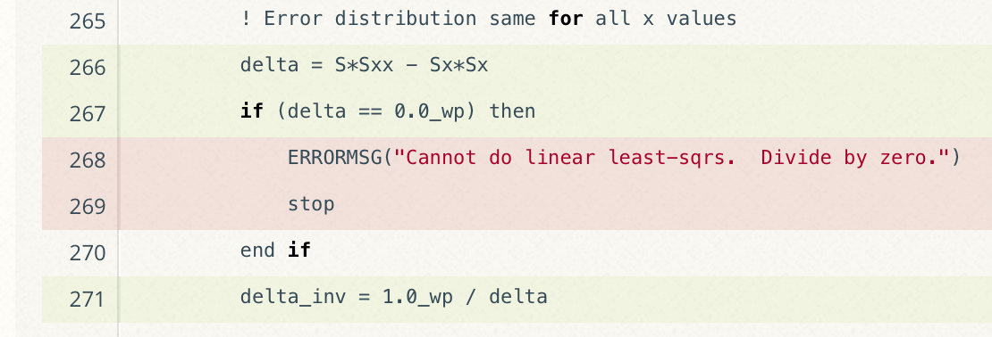
Code Coverage Output
Overall Analysis
Detailed Analysis
https://github.com/jrdoneal/infrastructure
Notes:
Missing testing of edge cases. This might be important!
Important to evaluate test frameworks to see if you can confirm that code is erroring correctly.

Slide 6
Code Coverage is Popular
gcov also works for C and Fortran
Other tools exist for other languages
JCov for Java
Coverage.py for python
Devel::Cover for perl
profile for MATLAB
etc.

Slide 7
Limitations
100% coverage by line
Checks 2 of 4 pathways only
Possibility for bugs
Notes:
If we want to use a tool, we would like to know how to use it, what it can do for us, and what it cannot.

Slide 8
Other Code Coverage
Test-Driven Development
Covers functionality coevolved with tests
Limited if we have only unit tests
Requirements & Verification
Covers higher-level functionality and constraints
Depends on completeness
Notes:
Code coverage by line is a great tool that gives us quick, useful results. Can we extend the way we do code coverage to help address limitations of by–line coverage?
For TDD, we can say that the code is correct within the scope of the test suite.
A lot of code coverage in these ways could be limited by combinatorics. Is it feasible to test every pathway? Is if feasible to develop comprehensive tests for all code that we write? If it possible to have a set of complete requirements such that the test suite that does requirement verification covers the code by 100%?

Slide 9

Agenda
Tutorial evaluation http://bit.ly/sc19-bssw-eval
Time | Module | Topic | Speaker
8:30am-8:40am | 00 | Introduction and Setup | David E. Bernholdt, ORNL
8:40am-9:15am | 01 | Overview of Best Practices in HPC Software Development | David E. Bernholdt, ORNL
9:15am-10:00am | 02 | An Introduction to Software Licensing | David E. Bernholdt, ORNL
10:00am-10:30am |  | Break
10:30am-11:30am | 03 | Agile Methodologies and Useful GitHub Tools | Michael A. Heroux, SNL
11:30am-12:00pm | 04 | Improving Reproducibility through Better Software Practices | Michael A. Heroux, SNL
12:00pm-1:30pm |  | Lunch
1:30pm-2:15pm | 05 | Software Design and Testing | Anshu Dubey, ANL
2:15pm-2:45pm | 06 | Git Workflows | Jared O’Neal, ANL
2:45pm-3:00pm | 07 | Code Coverage and Continuous Integration | Jared O’Neal, ANL
3:00-3:30pm |  | Break
3:30pm-3:50pm | 07 | Code Coverage and Continuous Integration (continued) | Jared O’Neal, ANL
3:50pm-5:00pm | 08 | Hands-on Activities and Additional Q&A | All

Slide 10
Additional Software-Related Events at SC19
Bold events (co-)organized by IDEAS
Day/Time | Event Type | Event Title
Sunday | Tutorial | Floating-Point Analysis and Reproducibility Tools for Scientific Software
Sunday | Workshop | The 2019 International Workshop on Software Engineering for HPC-Enabled Research (SE-HER 2019)
Monday | Tutorial | Better Scientific Software
Monday | Tutorial | Managing HPC Software Complexity with Spack
Monday | Workshop | 3nd International Workshop on Software Correctness for HPC Applications (Correctness 2019)
Monday | Students@SC | Students@SC: Modern Software Design, Tools, and Practices
Tuesday | BoF | Extreme-Scale Scientific Software Stack (E4S)
Tuesday | BoF | Exchanging Best Practices in Supporting Computational and Data-Intensive Research
Tuesday | Panel | Developing and Managing Research Software in Universities and National Labs
Wednesday | BoF | Software Engineering and Reuse in Modeling, Simulation, and Data Analytics for Science and Engineering
Thursday | BoF | Quality Assurance and Coding Standards for Parallel Software
Thursday | Panel | Sustainability of HPC Research Computing: Fostering Career Paths for Facilitators, Research Software Engineers, and Gateway Creators
Friday | Panel | The Road to Exascale and Beyond is Paved by Software: How Algorithms, Libraries and Tools Will Make Exascale Performance Real

Slide 11
Continuous Integration

Slide 12
The Short & Sweet of Continuous Integration
A master branch that always works
DVCS workflow isolate master from integration environment
Extend workflow to address difficulties of integrating
Minimize likelihood of merge conflict
Detect bugs immediately
Make debugging process quick and easy
Notes:
DVCS workflow is a step in the right direction, but is insufficient, for it does not necessarily impose rules that minimize the likelihood of merge conflicts. We also want to build into CI testing to make debugging quick and easy.

Slide 13
Work Decomposition
Commit and integrate often
Limit divergence between feature and master branches
Decreased probability of conflict
Conflict resolution is simpler and less risky

Slide 14
Error Detection
Test at integration to identify failures immediately
Control quality of code
Isolate failure to few commits
No context switching for programmer
We want a system that
triggers automated builds/tests on target environments when code changes and
ideally tests on proposed merge product without finalizing merge.

Slide 15
Test Servers
Servers that
automate the execution of a test suite or a subset of a test suite,
allow for running tests on different environments,
host an interface for viewing results, and
allows for configuring when the tests are run.
Examples
CTest/CDash
Jenkins
Travis CI and GitLab CI
Notes:
Emphasize that depending on services offered by service, the tests can be configured to commits/pull requests and by branch.
Also, would like to run some tests on a nightly basis. This is useful for large codes, where program execution could be prohibitive so that linking to commits would not be reasonable.
This where testing can be extended into continuous integration, which we will discuss later.

Slide 16
Cloud-based Test Servers
Linked to VCS hosts
GitHub & Travis CI
GitLab CI
BitBucket Pipelines
Automated builds/tests triggered via pushes and pull requests
Builds/tests can be run on cloud systems
Test results are reported in repository’s web interface
Can trigger code coverage analysis & documentation build
Notes:
No need to build and maintain a dedicated server.
Jenkins is another option. Not linked to any particular DVCS and can be built on dedicated server. Benefit is that you can often log into machine, setup and test your suite, and update/test new baselines when needed.

Slide 17
Continuous integration (CI)
Has existed for some time and interest is growing
HPC community working to adapt CI for HPC machines
Setup, maintenance, and monitoring required
Prerequisites
A reasonably-automated build system
An automated test system with significant test coverage & useful feedback
Builds/tests must finish in reasonable about of time
Ability to bundle subset of tests

Slide 18
CI Hello World
Simplest CI example
https://github.com/jrdoneal/CI_HelloWorld
https://travis-ci.org/jrdoneal/CI_HelloWorld
CI example w/ multiple platforms and specific compiler versions
https://github.com/jrdoneal/CI_Multiplatform
Code coverage, testing and CI tutorial (C++)
https://github.com/amklinv/morpheus
Code coverage, testing, and CI example (Fortran, C++)
https://github.com/jrdoneal/infrastructure

Slide 19
Agenda
Tutorial evaluation http://bit.ly/sc19-bssw-eval
Time | Module | Topic | Speaker
8:30am-8:40am | 00 | Introduction and Setup | David E. Bernholdt, ORNL
8:40am-9:15am | 01 | Overview of Best Practices in HPC Software Development | David E. Bernholdt, ORNL
9:15am-10:00am | 02 | An Introduction to Software Licensing | David E. Bernholdt, ORNL
10:00am-10:30am |  | Break
10:30am-11:30am | 03 | Agile Methodologies and Useful GitHub Tools | Michael A. Heroux, SNL
11:30am-12:00pm | 04 | Improving Reproducibility through Better Software Practices | Michael A. Heroux, SNL
12:00pm-1:30pm |  | Lunch
1:30pm-2:15pm | 05 | Software Design and Testing | Anshu Dubey, ANL
2:15pm-2:45pm | 06 | Git Workflows | Jared O’Neal, ANL
2:45pm-3:00pm | 07 | Code Coverage and Continuous Integration | Jared O’Neal, ANL
3:00-3:30pm |  | Break
3:30pm-3:50pm | 07 | Code Coverage and Continuous Integration (continued) | Jared O’Neal, ANL
3:50pm-5:00pm | 08 | Hands-on Activities and Additional Q&A | All

Slide 20
CI Hello World – Backup Slides

Slide 21
GitHub Repository Page
https://github.com/jrdoneal/CI_HelloWorld

Slide 22
Travis CI Configuration File
.travis.yml

Slide 23
The Script Phase
hello_world.sh

Slide 24
Connecting GitHub & Travis CI

Slide 25
Repository in Travis CI
https://travis-ci.org/jrdoneal/CI_HelloWorld

Slide 26
Commit History
.travis.yml
added

Slide 27
Travis CI Build History
Notes:
TRAVIS_CI_ENV not yet set in .travis.yml. We see that the echo is empty and that hello_world.sh caught the problem. Also Travis CI detects the correct exit code. The after_failure phase was correctly called.

Slide 28
Travis CI Build History
Notes:
TRAVIS_CI_ENV is now set in .travis.yml, which we can see in the log. Also, the echo is printing out a true statement and we see that hello_world.sh caught the problem. Also Travis CI detects the correct exit code. The after_failure phase was correctly called.

Slide 29
Travis CI Build History
!

